Slide 1
Endotracheal Intubation

Slide 2
Indications for intubation
Ineffective BMV - not resulting in adequate clinical improvement
Prolonged PPV
Along with chest compressions
Surfactant administration (INSURE)
Special situation
  Diaphragmatic hernia

Slide 3
Indications for intubation
Ineffective BMV- not resulting in adequate clinical improvement
Prolonged PPV
Along with chest compressions
Surfactant administration (INSURE)
Special situation
  Diaphragmatic hernia

Slide 4
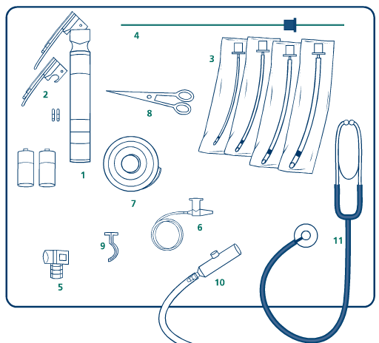
Equipments Required
4. Stylet (optional)
1.Larynoscope
8.Scissor
3. Endotracheal
tubes
2. Blades
6.Suction catheter
7.Tape
5.CO₂ monitor
9.Oral airway
11.Stethoscope
10.Meconium
aspirator

Slide 5
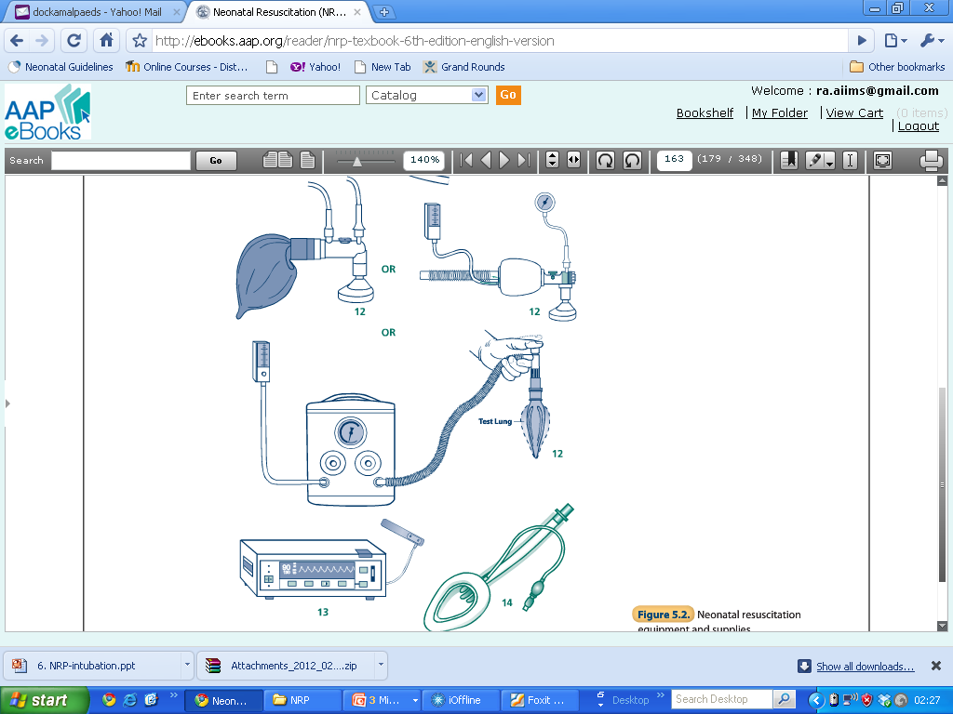
Equipments Required
12. Bag (anaestheia)
12. Self inflating bag
12.T piece
14.LMA
13.Pulse oximeter along with probe

Slide 6
Laryngoscope Blades Selection
No. 1 for full term
No. 0 for preterm / LBW
No. 00 for extremely preterm (optional)

Slide 7
Selecting Endotracheal Tube
Weight | Gest. Age | Tube Size ID
<1000 gm | < 28 wks | 2.5 mm
1000-2000 gm | 28-34 wks | 3.0 mm
>2000 gm | >34 wks | 3.5 mm
ID = Internal Diameter NRP 2016

Slide 8
Additional items
Tape | For securing the tube
Suction equipment | Mechanical suction Manual (mucus sucker)
Resuscitation Bag and Mask | To ventilate the infant in between intubation To check tube placement
Endotracheal Tube size | Catheter Size
2.5 | 5F or 6F
3.0 | 6F or 8F
3.5 | 8F
4.0 | 8F or 10F

Slide 9
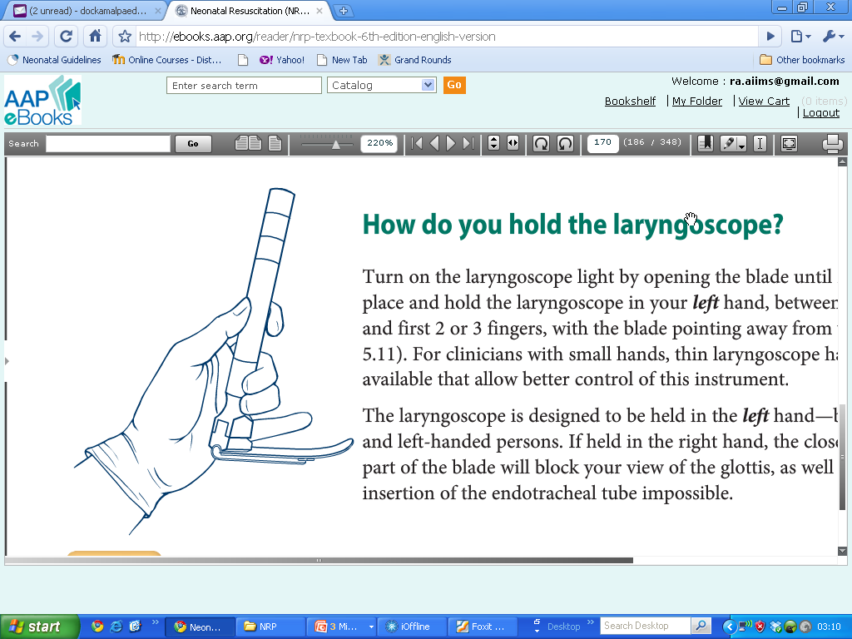
How to use the laryngoscope to insert an endotracheal tube

Slide 10
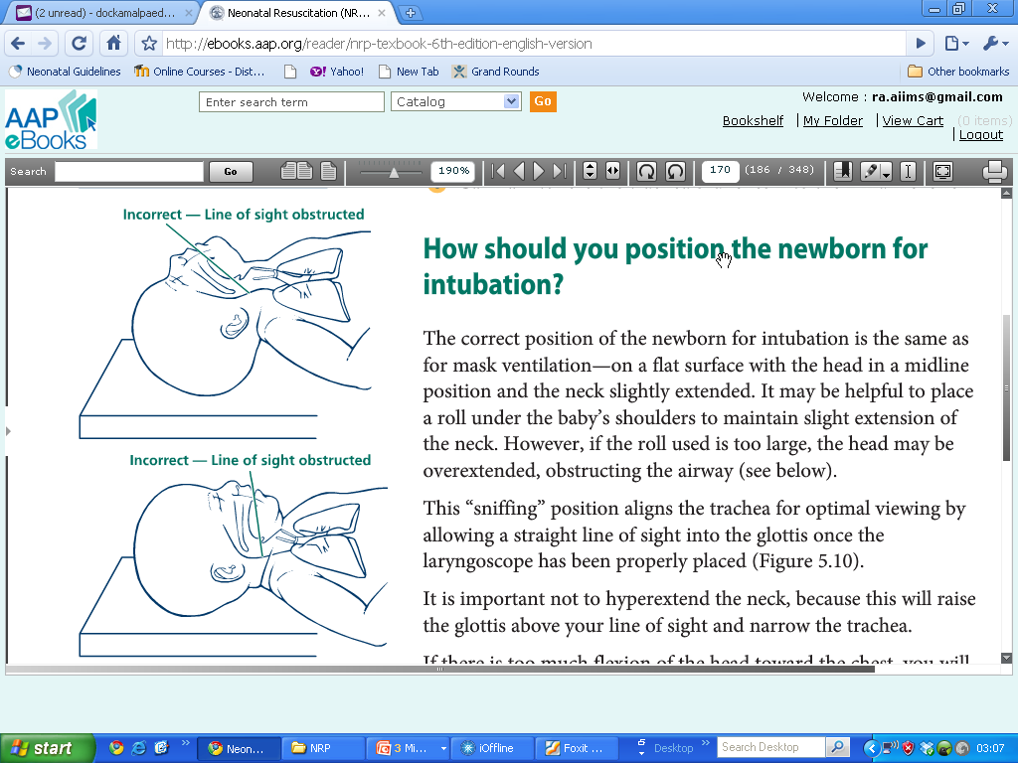
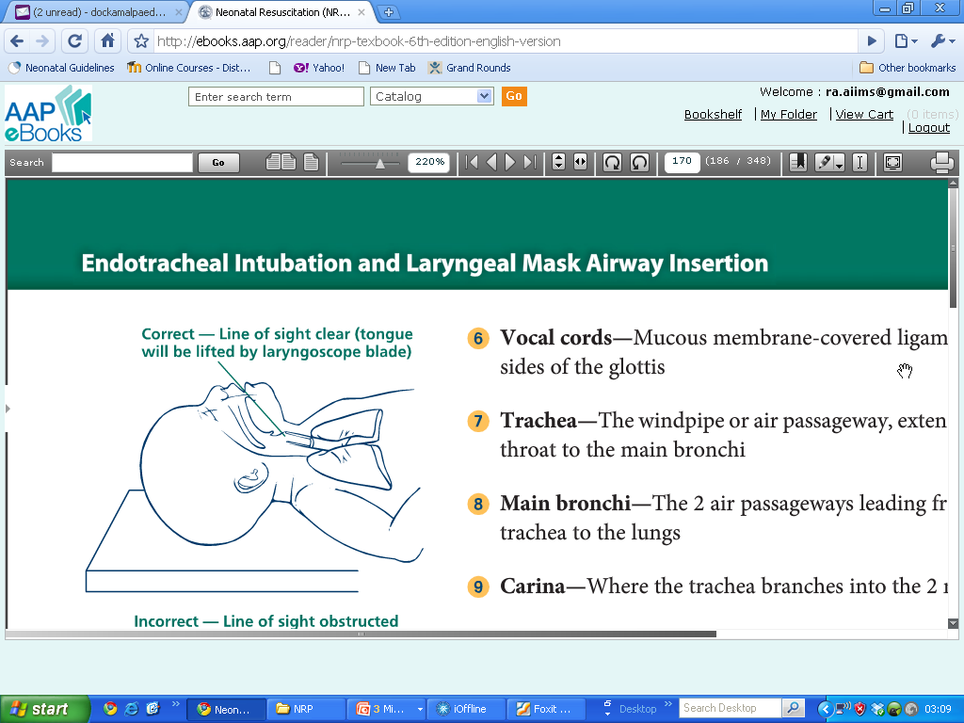
Positioning the infant
On a flat surface, head in midline and neck slightly extended
Optimal viewing of glottis

Slide 11
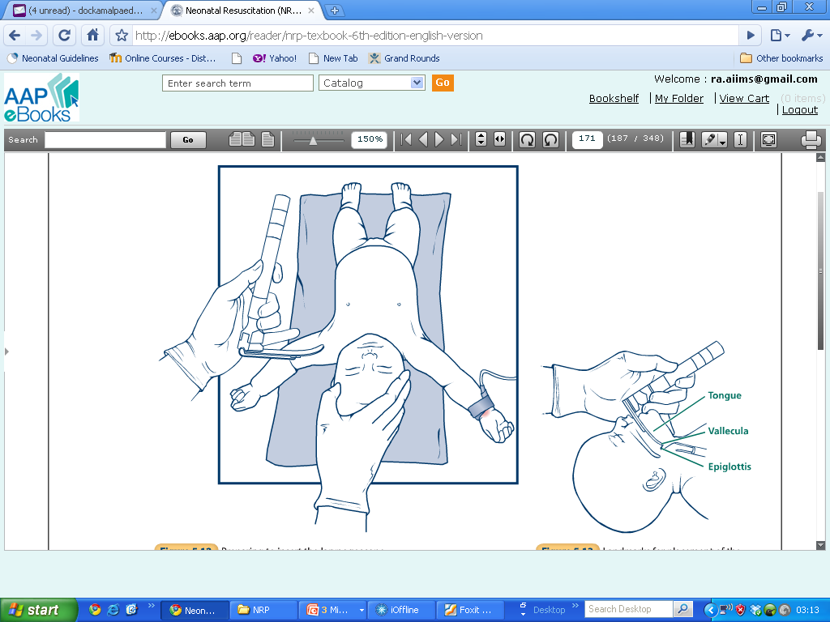
Preparing to insert the Laryngoscope
Stand at the head end of the infant
Hold the laryngoscope in your left hand
Stabilize the infant’s head with right hand

Slide 12
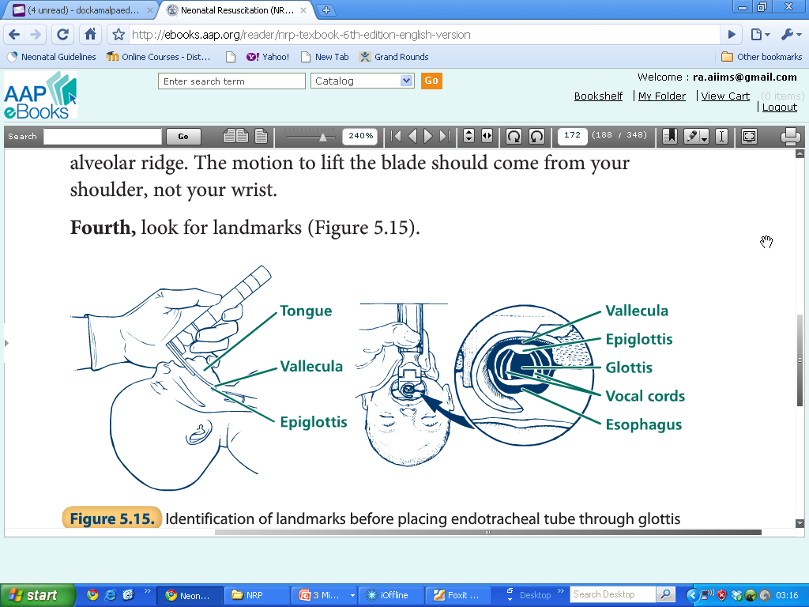
Landmarks for placing endotracheal tube

Slide 13
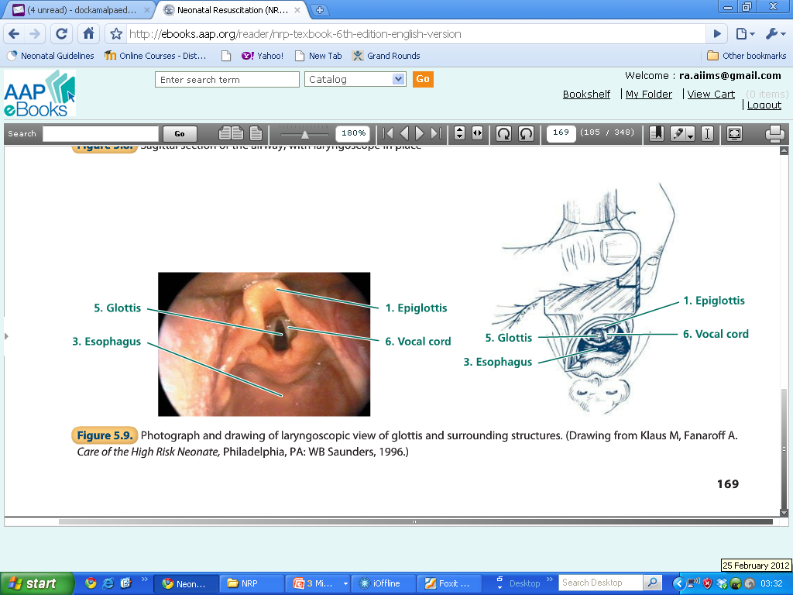
Landmarks for intubation

Slide 14
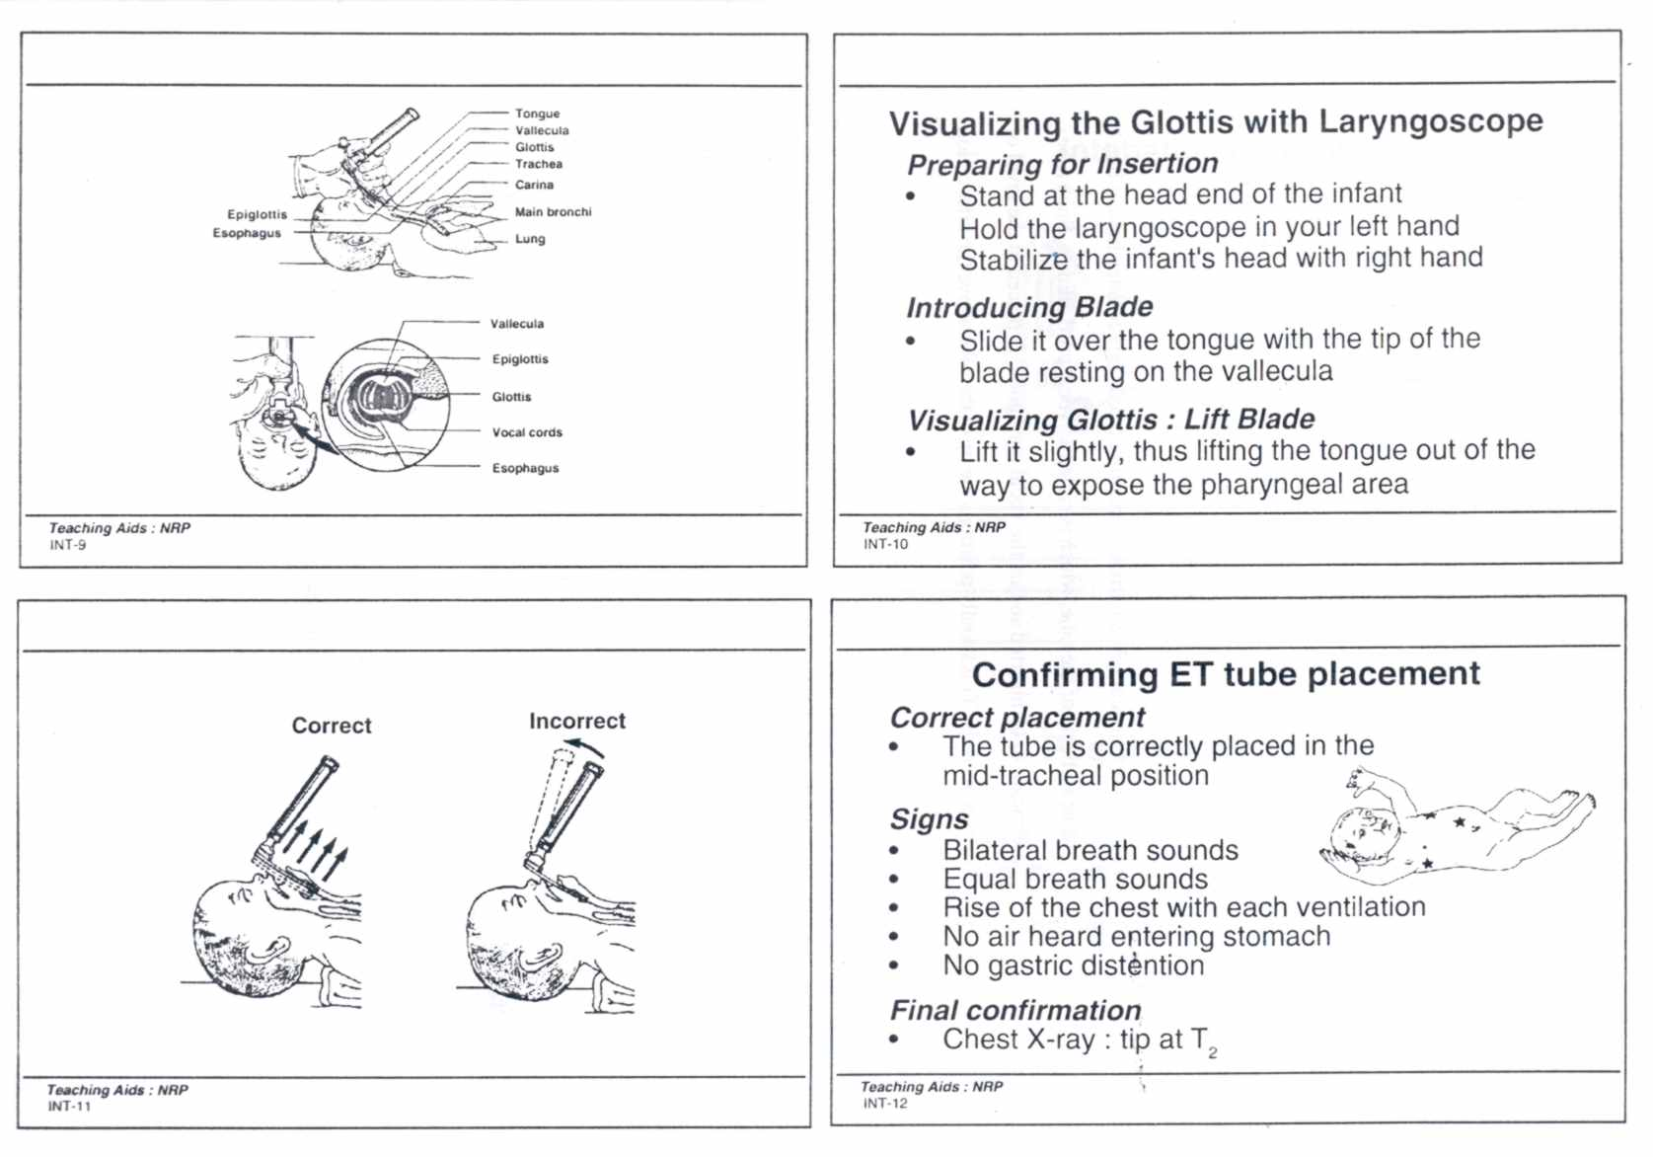
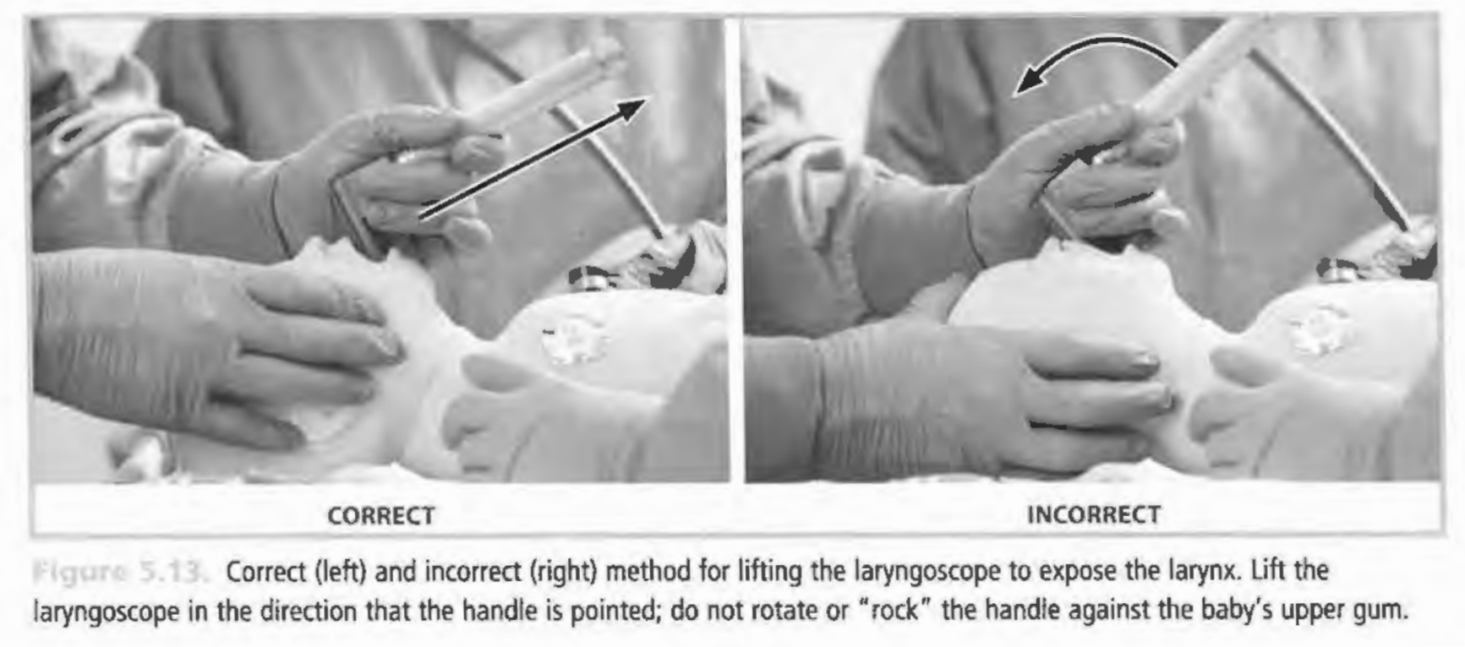

Slide 15
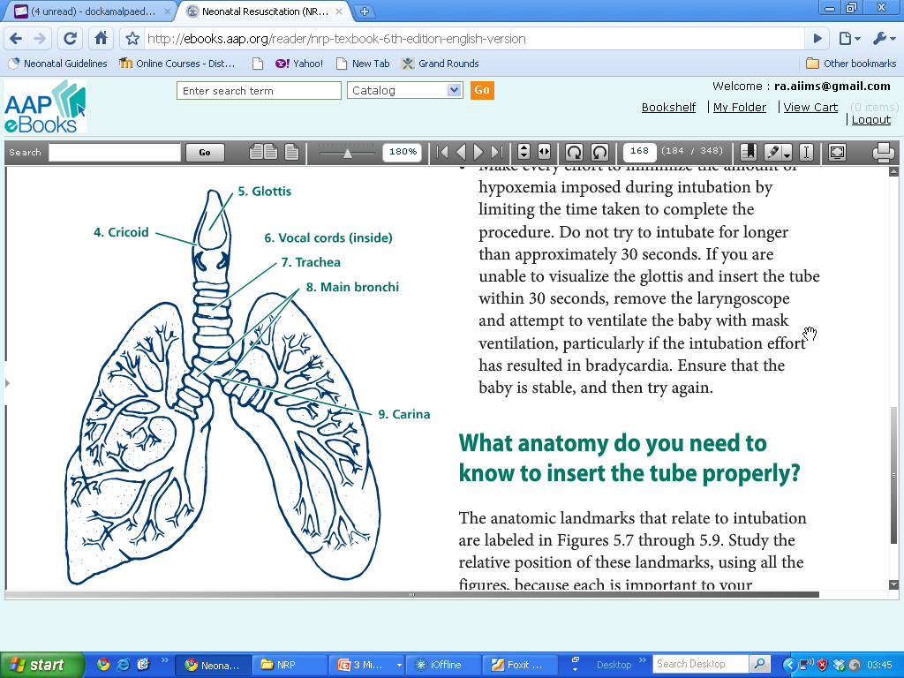
Anatomy - Beyond Glottis

Slide 16
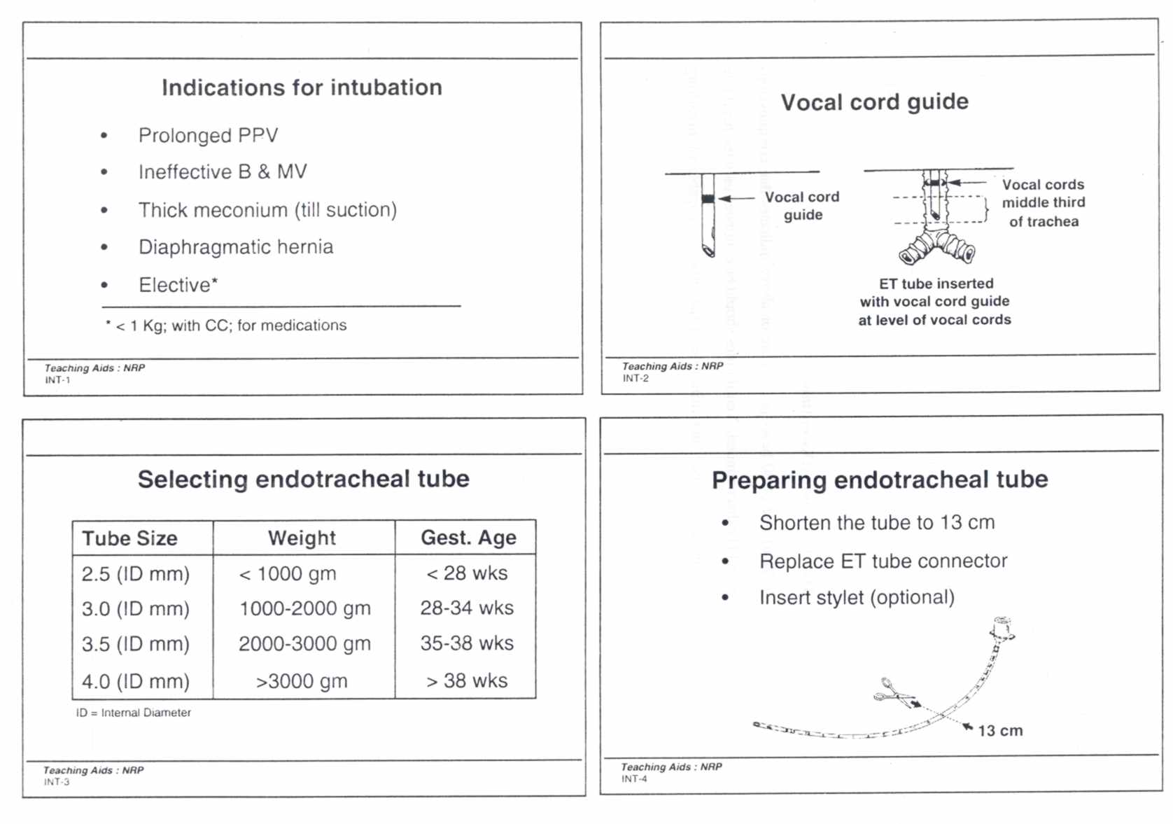
Vocal Cord Guide

Slide 17
Tip to lip distance (6+wt.in kg)
Weight | Distance
1 kg | 7 cm
2 kg | 8 cm
3 kg | 9 cm
4 kg | 10 cm

Slide 18
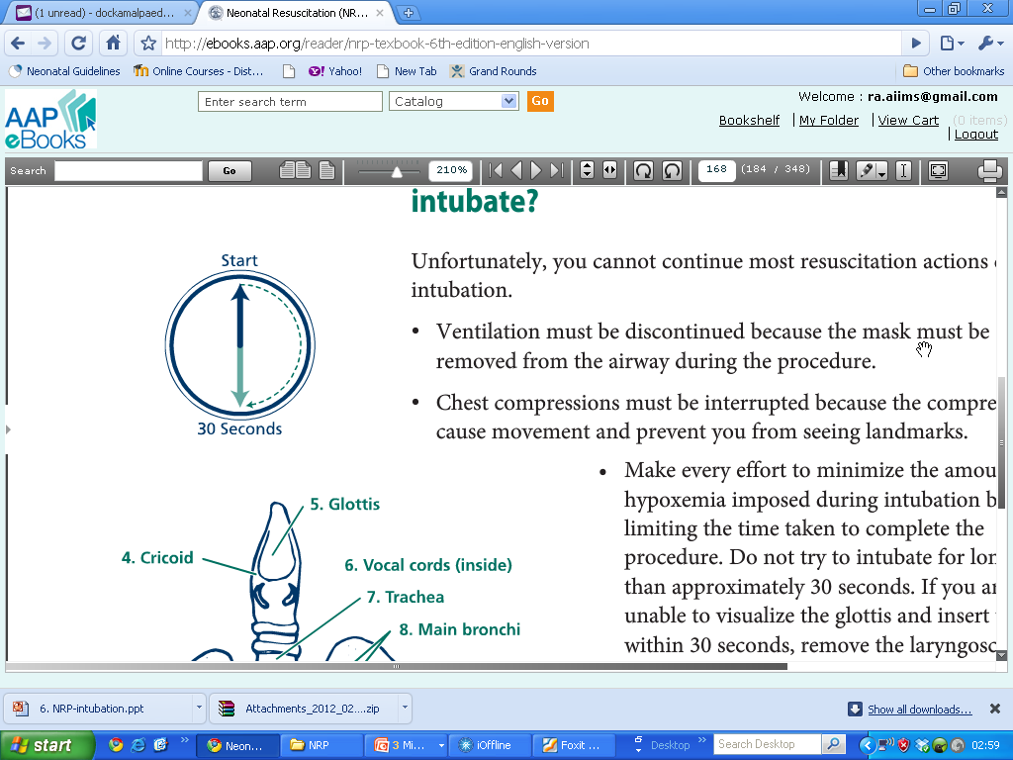
Confirming ET Tube Placement
Correct placement | ETCO₂ - the recommended method
Signs | Bilateral breath sounds Equal breath sounds, Mist in ET tube Rise of the chest with each ventilation No air heard entering stomach No gastric distention
Confirmation of tip position in trachea | Chest X-ray: tip at T₂

Slide 19
Fixation of Endotracheal Tube
Use your right hand to hold the tube securely against the baby's hard palate.
Carefully remove the laryngoscope without displacing the tube
Continue PPV
Fixation as shown

Slide 20
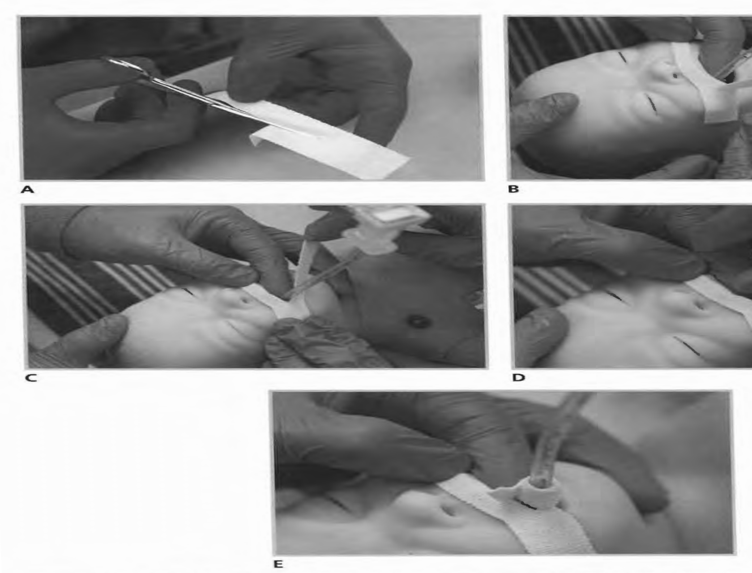

Slide 21
Tube in Rt. Main bronchus
Breath sounds only on right chest
No air heard entering stomach
No gastric distention
Action:
Withdraw the tube
Recheck

Slide 22
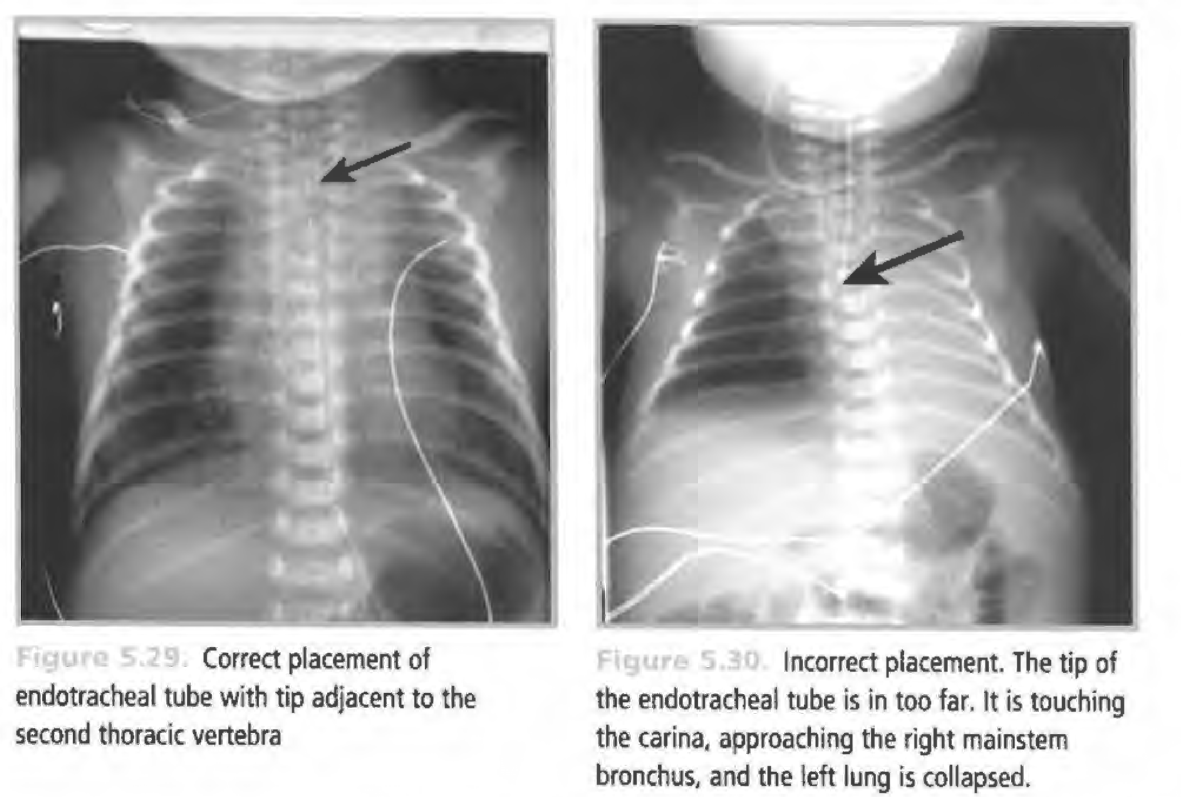
Correct Placement of Tube
Correct placement
Of endotracheal tube
with tip adjacent
to the
second thoracic
vertebra
Incorrect placement. The tip of
the endotracheal tube is in too far. It is touching the carina. approaching the right main stem bronchus, and the left lung is collapsed.

Slide 23
Tube in Esophagus
No breath sounds heard
Air heard entering stomach
Gastric distention may be seen
No mist in tube
No CO₂ in exhaled air
Action :
Remove the tube
Bag and mask ventilation
Reintroduce ET tube

Slide 24
Complications During Intubation
Complication | Possible cause | Prevention or corrective steps
Hypoxia | Taking too long to intubate Incorrect tube placement | Ventilate with mask if possible Halt intubation attempt after 30 seconds Reposition tube
Bradycardia/ apnea | Hypoxia Vagal response from laryngoscope or suction catheter | Ventilate with mask if possible Oxygenate after intubation Limit duration of intubation attempts
Pneumothorax | Over ventilate of one lung because of tube in right main bronchus Excessive pressure | Place tube correctly Use appropriate pressures
Contusions or lacerations of tongue | Rough handling of the laryngoscope Laryngoscope blade too long | Be gentle while manipulating the laryngoscope Have proper equipment
Infection | Introduction of infection from hands or instruments | Pay careful attention to clean technique

